Slide 2
Unit 2: DevOps Basics with Virtualization (5hrs)
Basics of Virtualization: Definition, Types, and Hierarchy of Virtualizations
Learn Virtualization: Manual and Automatic. OS Environments: Linux, MacOS, and Windows
Bash Scripting. Basics of Scripting
Variables, Conditions, Loops, etc.
Automating day-to-day Admin Tasks

Slide 3
Bash Scripting
Bash scripting is a powerful tool for automating tasks in Unix-based systems.
Bash, which stands for Bourne Again Shell, is a command-line interpreter that executes commands read from input or files.
A Bash script is essentially a text file containing a series of commands that the shell can execute sequentially.

Slide 4
Why Use Bash Scripting?
Automation: Simplifies repetitive tasks like backups, file manipulations, or system monitoring.
Efficiency: Executes commands faster than manual input.
Customization: Allows the creation of personalized workflows and tools.
Integration: Works seamlessly with other Unix utilities and commands.

Slide 5
Basics of Bash Scripting
Structure of a Bash Script
Start the script with a "shebang" (#!) to specify the interpreter.
Write commands line-by-line, as you would in the terminal.
#!/bin/bash
# This is a comment
echo "Hello, World!"

Slide 6
Basics of Bash Scripting
Making the Script Executable
Save the script with a .sh extension (e.g., script.sh).
Make it executable.
chmod +x script.sh
Run the script.
./script.sh

Slide 7
Bash Scripting: Variables
Variables store data that can be reused in the script.
#!/bin/bash
name="Shiva"
echo "Hello, $name!“
Variables are defined without spaces around the = sign.
Access them using $.

Slide 8
Bash Scripting: Conditional Statements
Bash supports if statements for decision-making.
Use [ ] for conditions.
Common operators:
-eq: Equal to
-ne: Not equal to
-gt: Greater than
-lt: Less than

Slide 9
Bash Scripting: Conditional Statements
#!/bin/bash
num=10
if [ $num -gt 5 ]; then
echo "$num is greater than 5"
else
echo "$num is less than or equal to 5"
fi

Slide 10
Bash Scripting: Loops
Loops help in iterating over a set of values.
For loop
#!/bin/bash
for i in 1 2 3 4 5; do
echo "Number: $i"
done
While loop
#!/bin/bash
count=1
while [ $count -le 5 ]; do
echo "Count: $count"
((count++))
done

Slide 11
Bash Scripting: Functions
Functions encapsulate reusable blocks of code.
$1 is a positional parameter for passing arguments to the function.
#!/bin/bash
greet() {
echo "Hello, $1!"
}
greet "Shiva"

Slide 12
Bash Scripting: Input/Output
Read input from the user.
echo "Enter your name:"
read name
echo "Hello, $name!"

Slide 13
Common Use Case of Bash Scripting
File Management
# Rename files in a directory
for file in *.txt; do
mv "$file" "new_$file"
done

Slide 14
Common Use Case of Bash Scripting
Backup Automation
# Create a tar archive of a directory
tar -czf backup.tar.gz /path/to/directory

Slide 15
Common Use Case of Bash Scripting
System Monitoring
# Check disk usage
df -h | grep "/dev/sda“
df –h lists all the processes running in device in human-readable format(-h)
grep “/dev/sda” lists the processes that match the term “/dev/sda”

Slide 16
Common Use Case of Bash Scripting
User Management
# Add a new user
sudo useradd newuser

Slide 17
Common Use Case of Bash Scripting
Checking if the file exists
# Check if the file exists
if [ -f "$filename" ]; then
echo "The file '$filename' exists.“
else
echo "The file '$filename' does not exist.“
fi

Slide 18
File and Directory Commands
Command | Description | Example
ls | List files and directories | Ls –l
pwd | Print the current working directory | pwd
cd | Change the directory | cd /home/user
mkdir | Create a new directory | mkdir mydir
rm | Remove files or directories | rm file.txt, rm -r mydir
cp | Copy files or directories | cp file1.txt file2.txt
mv | Move or rename files/directories | mv oldname.txt newname.txt
touch | Create a new file | touch file1.txt

Slide 19
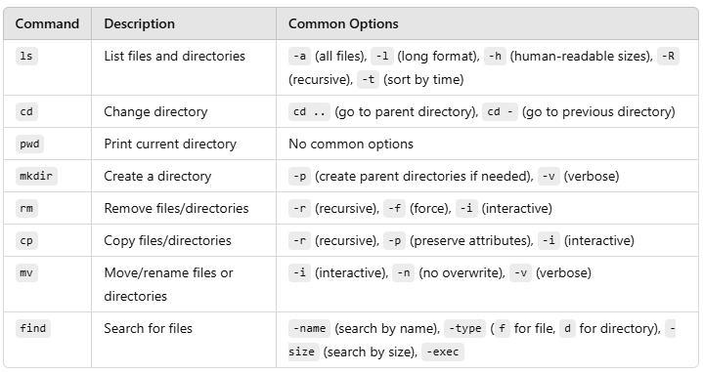
File and Directory Commands

Slide 20
Text Manipulation Commands
Command | Description | Example
echo | Print text to the terminal | echo "Hello, World!"
cat | Display file contents | cat file.txt
less | View file contents one screen at a time | less file.txt
head | Display the first few lines of a file | head -n 5 file.txt
tail | Display the last few lines of a file | tail -n 5 file.txt
wc | Count words, lines, or characters in a file | wc -l file.txt

Slide 21
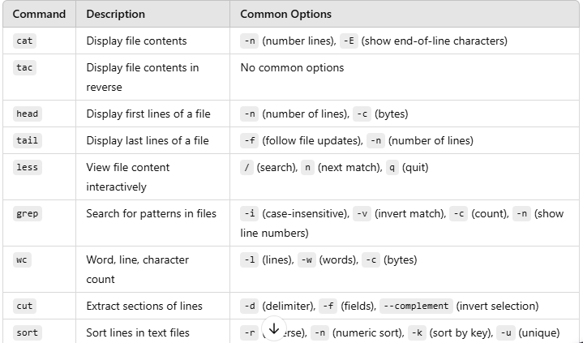
Text Manipulation Commands

Slide 22
Process Management
Command | Description | Example
ps | Display current processes | ps -aux
top | Monitor system resources and processes | top
kill | Terminate a process by PID | kill 1234
bg | Resume a process in the background | bg %1
fg | Bring a background process to the foreground | fg %1

Slide 23
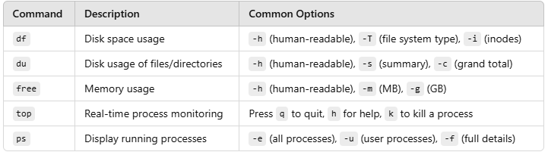
Disk and System Usage

Slide 24
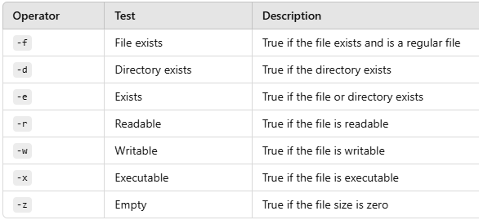
File Testing Operators

Slide 25
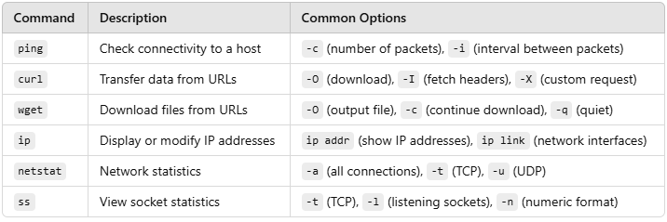
Networking and System Info

Slide 26
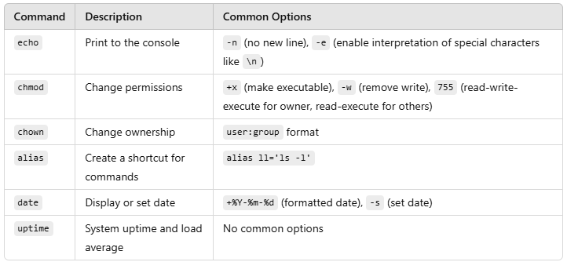
Miscellaneous Commands

Slide 27
Tips for Writing Effective Bash Scripts
Comment Your Code: Use # to explain the purpose of commands.
Error Handling: Use || for fallback commands. mkdir /test || echo "Failed to create directory"
Debugging: Run the script with bash -x to debug line-by-line.
Portability: Write scripts that work across different Unix-based systems.
Log Messages: Add log statements for clarity.

Slide 28
Automating day-to-day Admin Tasks
Automating routine administrative tasks can significantly improve productivity, reduce manual errors, and simplify system management.
It helps to efficiently manage repetitive tasks.
Here are a few examples of automated tasks and their solutions:

Slide 29
System Updates
Automate System Updates
#!/bin/bash
echo "Starting system update..."
sudo apt update && sudo apt upgrade -y
echo "Update completed on $(date)" >> /var/log/sysupdate.log

Slide 30
User Management
Add Multiple Users from a File
Script to read usernames from a file and create users:
#!/bin/bash
while IFS= read -r user; do
sudo useradd "$user"
echo "User $user created."
done < users.txt

Slide 31
Backup Files and Directories
Daily Backup with Timestamp
Automatically backup a directory with a timestamp.
#!/bin/bash
backup_dir="/home/shiva/backup"
src_dir="/var/www/html"
timestamp=$(date +"%Y%m%d%H%M")
mkdir -p "$backup_dir"
tar -czf "$backup_dir/backup_$timestamp.tar.gz" "$src_dir"
echo "Backup completed: $backup_dir/backup_$timestamp.tar.gz"

Slide 32
Disk Usage Monitoring
Send Alerts for Low Disk Space
Automatically check disk usage and alert if usage exceeds a threshold.
#!/bin/bash
threshold=80
usage=$(df / | grep '/' | awk '{print $5}' | sed 's/%//')
if [ "$usage" -gt "$threshold" ]; then
echo "Disk space usage is above $threshold%. Current usage: $usage%" | mail -s "Disk Space Alert" admin@example.com
fi

Slide 33
Log Monitoring
Track Unauthorized Login Attempts
Monitor /var/log/auth.log for unauthorized login attempts.
#!/bin/bash
log_file="/var/log/auth.log"
grep "Failed password" "$log_file" | awk '{print $1, $2, $3, $11}' > failed_attempts.txt
echo "Unauthorized login attempts logged in failed_attempts.txt"

Slide 34
System Updates
Automatic Package Updates
Update system packages and log the output.
#!/bin/bash
log_file="/var/log/update_log.txt"
sudo apt-get update && sudo apt-get upgrade -y > "$log_file" 2>&1
echo "System updated. Log saved to $log_file."

Slide 35
Network Monitoring
Ping Test for Critical Services
Check if critical services are reachable and log results.
#!/bin/bash
servers=("google.com" "github.com" "example.com")
for server in "${servers[@]}"; do
if ping -c 1 "$server" &>/dev/null; then
echo "$server is reachable"
else
echo "$server is not reachable" >> unreachable.log
fi
done

Slide 36
Automation Process
Step 1: Save the Script
Create a shell script file.
nano ping_monitor.sh
Copy and paste the ping test script into the file.
Save and exit the file.
#!/bin/bash
# List of servers to monitor
servers=("google.com" "github.com" "example.com")
# Log file to store results
log_file="/var/log/ping_monitor.log"
# Check each server
for server in "${servers[@]}"; do
if ping -c 1 "$server" &>/dev/null; then
echo "$(date): $server is reachable" >> "$log_file"
else
echo "$(date): $server is NOT reachable" >> "$log_file"
fi
done

Slide 37
Automation Process
Step 2: Make the script executable
Change the permission to make the file executable.
chmod +x ping_monitor.sh

Slide 38
Automation Process
Step 3: Schedule the Script with Cron
To automate the script and run it at regular intervals, use cron jobs:
Open the cron editor:
crontab –e
Add a line to schedule the script. For example:
Run the script every 10 minutes:
*/10 * * * * /path/to/ping_monitor.sh
Run it every hour:
0 * * * * /path/to/ping_monitor.sh
Save and exit.

Slide 39
Automation Process
Step 4: Verify Automation
Check if the cron job is running:
grep CRON /var/log/syslog
Open the log file to view results:
cat /var/log/ping_monitor.log

Slide 40
Automation Process
Step 5: Notification Options
Send Alerts for Downtime:
Integrate an email or messaging system to send alerts for unreachable servers. Add this line inside the else block:
echo "$(date): $server is NOT reachable" | mail -s "Ping Alert: $server Down" admin@example.com
Customizing the Script:
Add more advanced logic, like retrying the ping or using curl to check specific ports.

Slide 41
Scheduling Tasks with Cron Jobs
Cron is a time-based job scheduler in Unix-like systems.
* * * * * /path/to/script.sh
│ │ │ │ │
│ │ │ │ └─ Day of the week (0 - 6) (Sunday = 0)
│ │ │ └──── Month (1 - 12)
│ │ └────── Day of month (1 - 31)
│ └──────── Hour (0 - 23)
└────────── Minute (0 - 59)

Slide 42
Scheduling Tasks with Cron Jobs
Examples:
Run backup daily at 1AM
0 1 * * * /home/user/backup.sh
Reboot system every Sunday at 3AM
0 3 * * 0 /sbin/reboot

Slide 43
Cron Jobs for Automation
Schedule scripts to run automatically using cron jobs.
Example: Run a backup script daily at 2 AM.
0 2 * * * /home/shiva/backup_script.sh
Add this line to the crontab:
crontab -e

Slide 44
Scheduled Cleanup
Delete Old Files
Remove files older than 7 days in a directory.
#!/bin/bash
find /path/to/directory -type f -mtime +7 -exec rm -f {} \;
echo "Old files deleted."

Slide 45
Database Backup
Automated MySQL Database Backup
Backup a MySQL database and compress it.
#!/bin/bash
db_name="my_database"
backup_dir="/home/shiva/db_backup"
timestamp=$(date +"%Y%m%d")
mkdir -p "$backup_dir"
mysqldump -u root -p "$db_name" > "$backup_dir/db_backup_$timestamp.sql"
gzip "$backup_dir/db_backup_$timestamp.sql"
echo "Database backup completed: $backup_dir/db_backup_$timestamp.sql.gz"

Slide 46
End of Lecture 6

Slide 47
DEVOPS ON CLOUD

